Slide 1
自我
介紹

Slide 2
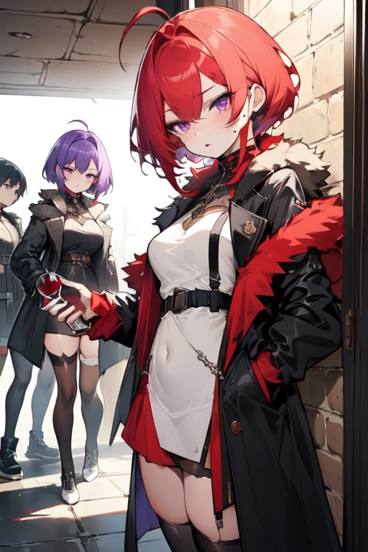
目 標
Notes:
ahoge, (wine_red_hair), short_hair, eyebrow_moles, purple_eyes, wearing_vampire_coat, white_thighhighs, black_footwear, girl, girl leans against a wall, group_of_gaming_players,

Slide 3
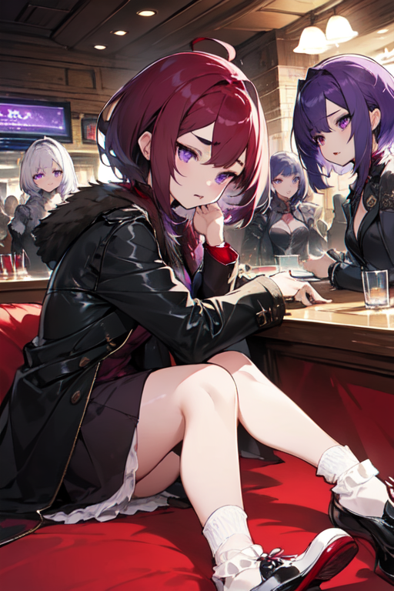
阻 礙
Notes:
ahoge, (burgundy_hair), short_hair, eyebrow_bush, (purple_eyes), wearing_vampire_coat, white_socks, black_leather_shoes, girl, bar_(place), side-lying, chatting, multiple_girls, crowd_of_gamers,

Slide 4
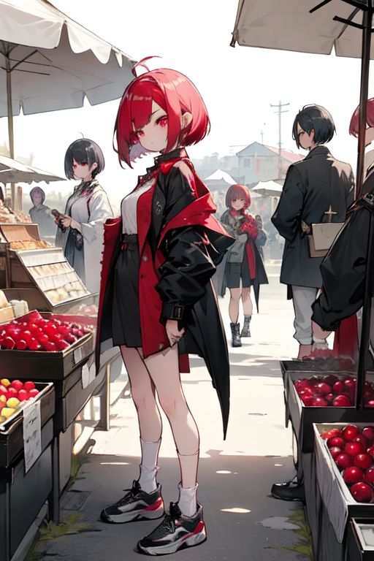
努 力
Notes:
ahoge, (cranberry_hair), bob_cut, eyebrow_jewels, (plum_eyes), wearing a vampire coat, ( (short_white_socks) ), (black_shoes), girl, troubled_expression, standing, marketplace, vendor, bustling, out_of_place, group_of_gamer_players, enhanced_quality

Slide 5
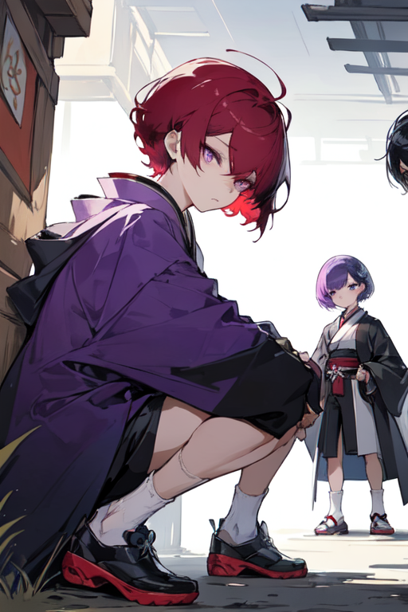
結 果
Notes:
Japanese-style live2D painting style, 2D graphics, full of game-like atmosphere, A girl with burgundy short hair, double eyelids, purple round eyes, wearing a European-style ornamental coat, white short socks, and black round heel shoes is crouching on the wall, observing a group of gamers 1boy,high quality

Slide 6
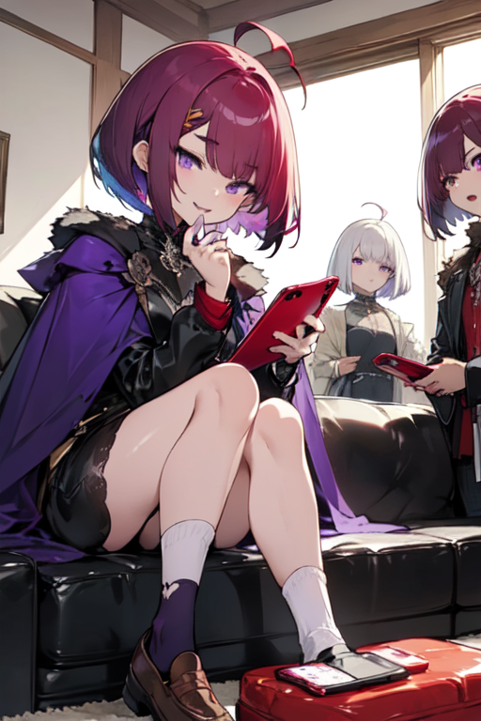
意 外
Notes:
ahoge, (burgundy_hair), bob_cut, two-tone_eyebrows, (purple_eyes), wearing_vampire_cape, (short_white_socks), (black_leather_loafers), sitting on couch, otaku, holding_cellphone, cellphone_view, surprised_expression, happy_expression, group_of_gaming_players, enhanced_quality

Slide 7
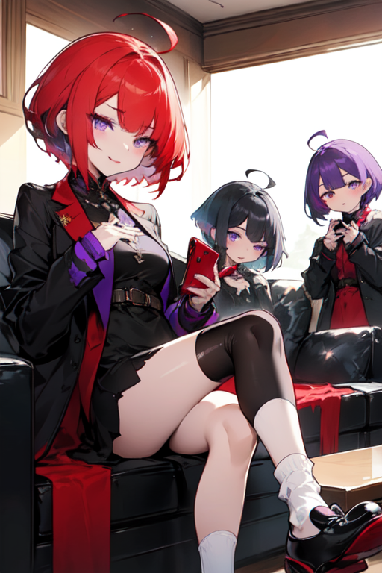
轉 折
Notes:
ahoge, (crimson_hair), short_hair, eyebrow_shadow, (purple_eyes), wearing_vampire_coat, ( (short_white_socks) ), (black_footwear), sitting_on_couch, girl, holding_phone, phone_image, surprised_expression, happy_expression, multiple_girls, graphics_boost

Slide 8
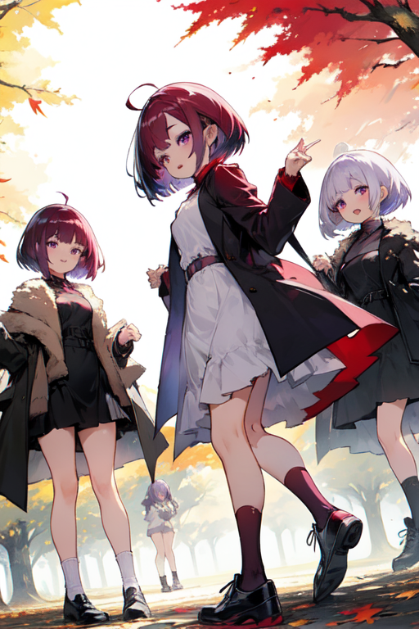
結 局
Notes:
ahoge, (burgundy_hair), bob_cut, eyebrow_bumps, (purple_eyes), wearing_vampire_coat, (short_white_socks), (black_footwear), under_large_tree, girl, lively, celebration, expression_happy, multiple_girls, uhd, outdoors, autumn_leaves, sunlight, vibrant

